Slide 1
Generative AI Models
Text To Image Generator
Image To Text Generator
By: Islam Abd_Elhady
LinkedIn: Islam Abd_Elhady
GitHub: Islam Abd_Elhady

Slide 2
What is Generative AI?
Generative AI is a type of artificial intelligence technology that can produce various types of content, including text, imagery, audio and synthetic data. The recent buzz around generative AI has been driven by the simplicity of new user interfaces for creating high-quality text, graphics and videos in a matter of seconds.

Slide 3

How to use generative AI easily?
Using Hugging Face platform.
What is Hugging Face? Hugging Face is a machine learning (ML) and data science platform and community that helps...
It contains many different pre-trained models that can be used directly for various tasks.

Slide 4
I used Hugging Face to build two models:
1. Text To Image Generator
2. Image To Text Generator
Generate images from textual descriptions using the Stable Diffusion model.
Generate descriptive captions for images.

Slide 5
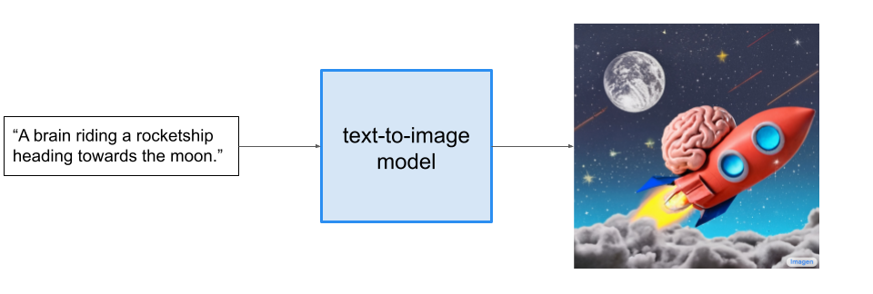
Model 1: Text To Image Generator
Model Overview: Uses a diffusion model to create high-quality images from text prompts.
Colab Template: text_to_image_generator

Slide 6
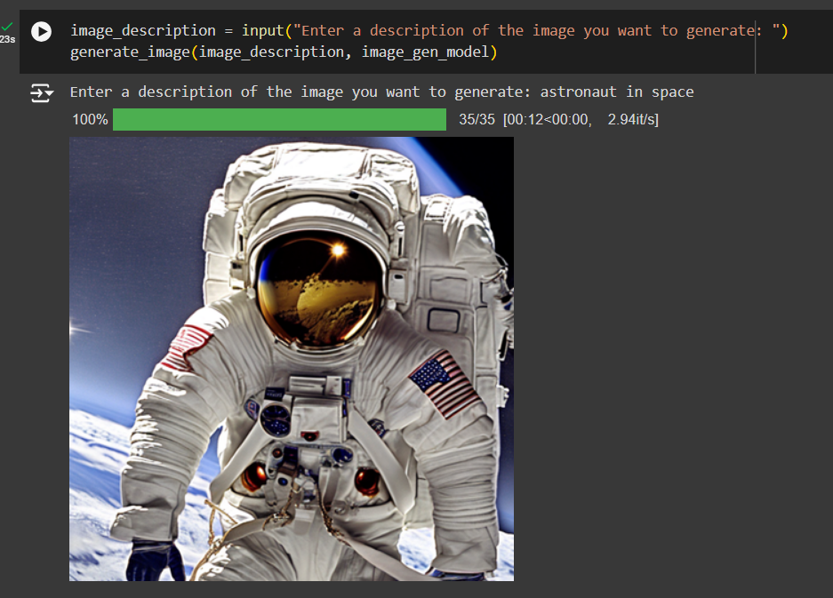
Image Generation Output

Slide 7
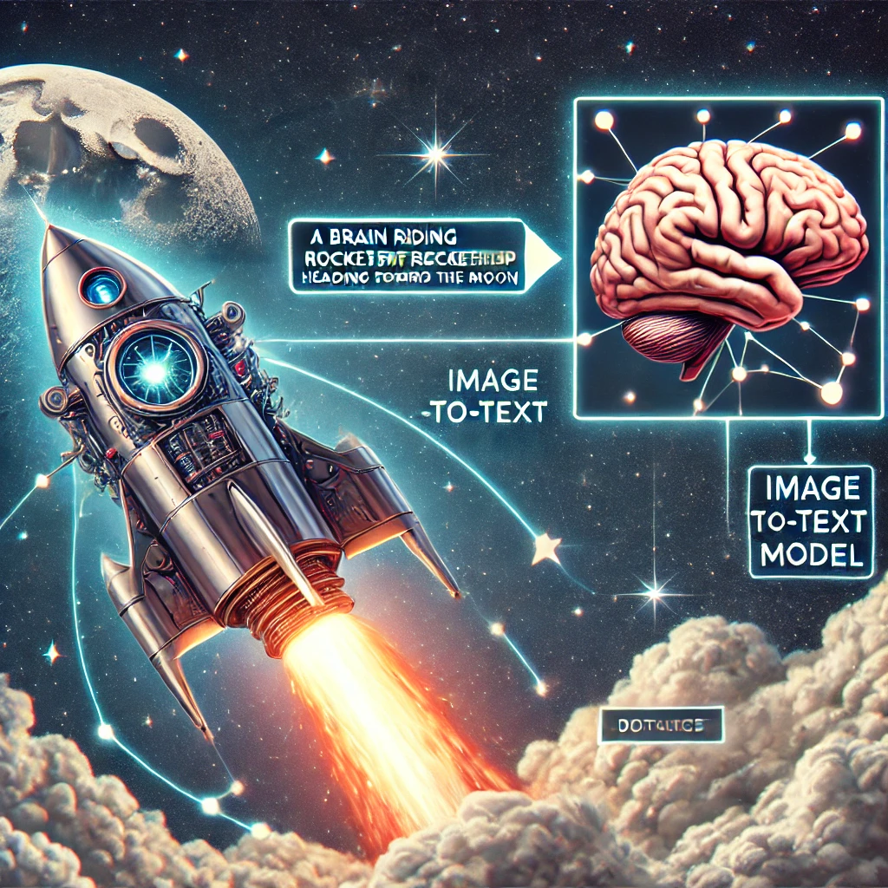
Model 2: Image To Text Generator
Model Overview: Combines ViT for image processing and GPT-2 for text generation.
Colab Template: image_to_text_generator

Slide 8
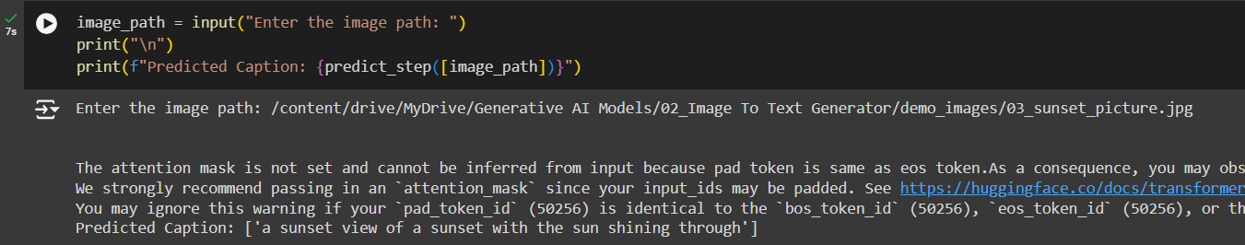
Text Generation Output

Slide 9
Project link on GitHub
Project Repository: Access the full project on GitHub to view the code, documentation, and deployment details.
Link: https://github.com/Islam-hady9/Generative-AI-Models

